Slide 1
GeoJSON Visualizer
Ben Gorgan

Slide 2
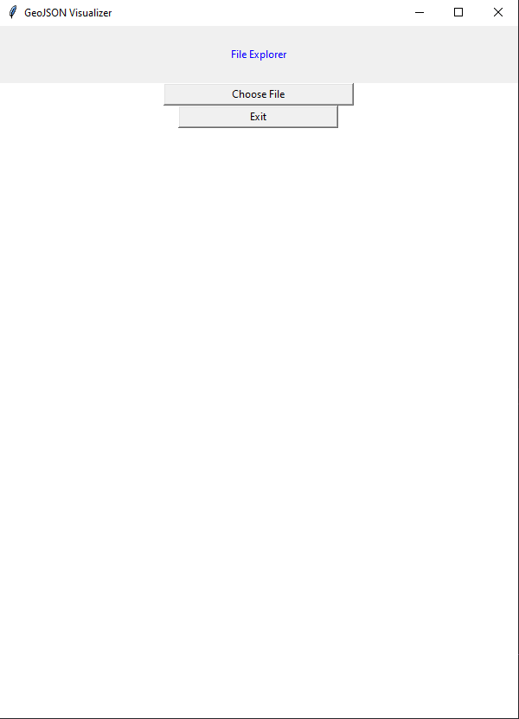
Opening Interface
When initially running the application, a simple user interface will appear allowing you to choose a file, or exit the application.
Choosing a file will bring up a window that you can use to browse your system to find the file you want view. Exit, will just close the application

Slide 3
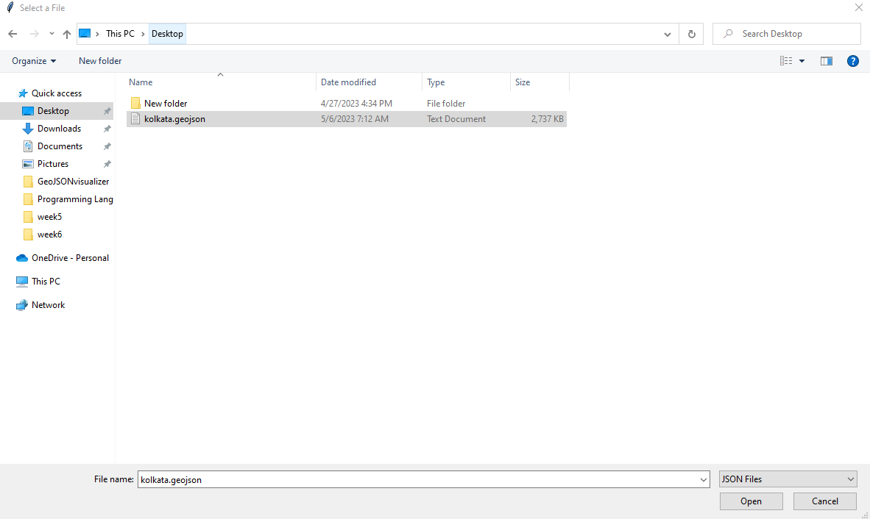
File Selection
This is the file selection screen that pops up after pressing the ‘Choose File’ button.
This is just the default file browser for Windows.
This application processes files with the .geojson file extension.

Slide 4
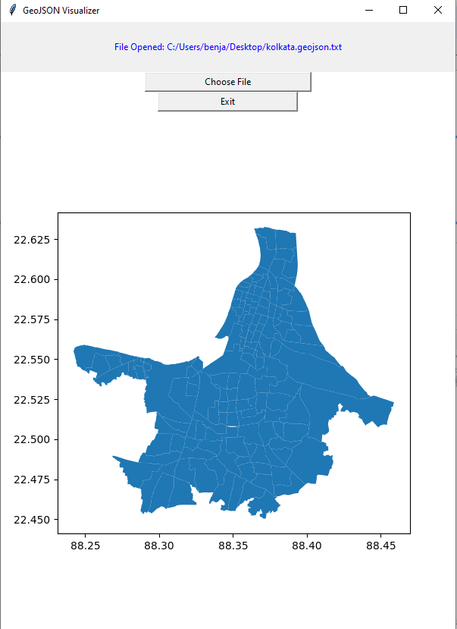
GeoJSON Plot
Finally, after selecting a file, a plot will be created using the GeoJSON file that the user has selected.
The plot takes the information from the file, and renders out all of the borders for the different plots of land.
Based on the information contained in the file, there are many different options that can be applied to this plot. I only used the most basic plot, because I was unsure of what information would be contained in different files.

